Slide 1
Skills for Computing
Topic 10:
Accuracy and Correlation ; Presenting Results
Notes:
NCC Education - Title Master

Slide 2
Learning Outcomes for this Topic
By the end of this topic students should be able to:
  Use standard errors
  Represent and analyse paired data
  Recognise and interpret correlation
  Analyse and present results correctly
  Understand ways in which statistics are misused
  Learn to recognise mistakes in the way others present results

Slide 3
Uncertainty - 1
  A useful description of any statistical result must include the statistical error
  The error shows the uncertainty of a result.
  In this module we deal with random variations. Not all errors can be handled with statistics.

Slide 4
Uncertainty - 2
  Random variations are caused by changes in the environmental conditions, or in the measurement system.
  We use statistics to handle this type of error. We need a large number of values for accurate results.

Slide 5
Other Errors
  User error:
    For example not entering a value correctly or omitting it, or not using the correct units.
  Systematic error:
    This can affect all the measurements in the dataset.
    For example “zero error”: not measuring length starting from the beginning of a ruler (the zero.)
    It is an error in procedure; it does not vary randomly.

Slide 6
Example
  How much rain falls per month in England on average?
    Answer 1: 82.1
      This answer is totally meaningless (and would get zero marks in an examination!)
    Answer 2: 82.1 cm
      This answer is better, but it seems strange that it rains exactly the same amount every month of every year!
    Answer 2: 82.1 cm ± 31.8 cm
      This is correct: it tells us a value, and how much variation there is in that value

Slide 7
Sources of Error - 1
  Bias:
    We can introduce errors before we start the measurement, if we make measurements in a way which changes the distribution of values.
    This type of error is called “bias” and is usually caused by poor experimental design.
    For example, when we obtain results from a survey, we are not obtaining information about the general population, only about people who have the time and patience to complete a survey.

Slide 8
Sources of Error - 2
  Noise:
    No measuring device is perfect, there will be some noise in the measurements.
    Noise can also be caused by changing conditions and interactions with the environment.

Slide 9
Sources of Error - 3
  Representation of values:
    We can also introduce error when we have already made the measurement.
    Rounding error: The online storage format uses fewer digits than the original data, changing its value.
    Transfer error: This could be user error, or faulty communication between instrumentation and online storage. This type of error can be very large when it occurs.

Slide 10
Standard Error - 1
  Gives a measure of the distance of data values from the mean.
    More accurate values, for example from more careful measurements, will have a smaller standard error.
    The standard error is usually given as a range: the mean ± the standard error, for example 10 ±2.
  The standard error is an estimate of the standard deviation.

Slide 11
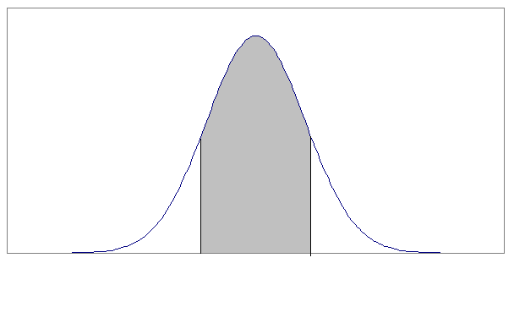
Standard Error - 2
  The shaded area shows the range of values that lies within a distance of one standard error from the mean.
8
12

Slide 12
Standard Error - 3
  The range of values which lie within one standard error either side of the mean is called the “spread”. About 70% of the values will be in this range.
  Another way of looking at this is that there is a probability of about 70% that a measurement will be close to the estimated mean (separated by at most one standard error.)

Slide 13
Standard Error - 4
  Sometimes scientists use a spread of ±two standard errors. In this case the spread covers about 95% of the range of values.
  We call this the 95% confidence interval. This means that about 95% of the time we will include the exact mean in this interval.

Slide 14
Combining Errors
  If measurements of different quantities are combined algebraically, then if they are uncorrelated we can usually combine the errors to obtain the error in the result.
  If we add or subtract quantities, the resulting standard error is the root of the sum of the individual standard errors.
  If we multiply or divide quantities, this rule applies to the relative standard error (the error divided by the quantity.)

Slide 15
Dependence
  We can combine data from two randomly varying quantities, to explore their relationship.
  If they are independent of each other, then analysing their combined values is the same as analysing them separately.
  We are often interested in whether one quantity directly changes another. We cannot determine this from statistical data analysis.
  However, even if all we know is that they vary in a similar way, this can be useful. For example, if one of the things is difficult to measure, we can deduce its value from the behaviour of the other.

Slide 16
Scatter Plots - 1
  We can visualise paired data values using a scatter plot.
    A scatter plot gives us a 2-dimensional picture of the combined relative frequencies. Denser regions, where values are clumped together, are combinations of values which occur often.
    Denser regions can also occur if one of the quantities has a higher relative frequency in that region, even if the data pairs are independent. In this case, the clustering will be along a horizontal and/or vertical direction.

Slide 17
Scatter Plots - 2
Correlated
Uncorrelated

Slide 18
Correlation - 1
  Correlated values
    If the distribution of values of one quantity changes shape (for example, has a different mean) according to the values of the other, then the quantities are correlated.
    In this case, if we know the value of one quantity, we have some partial information about the value of the other.
    In the scatter plot shown previously, if you know that someone is very tall, then you can guess that they probably weigh a lot.

Slide 19
Correlation - 2
  Uncorrelated quantities
    If the distribution of values of one quantity is the same for all values of the other, there is no statistical connection between them and we say they are “uncorrelated”.
    In this case, if we know the value of one quantity, that gives us no information about the value of the other.
    In the scatter plot shown previously, although some heights are more likely than others, knowing in which month someone was born does not help you to guess their height.

Slide 20
Lecture 2

Slide 21
Using Statistics
  Statistical analysis of quantitative data is a powerful tool for summarising information.
  However, a summary of nonsense is still nonsense.
  Expressing information using numbers does not mean it is always true or meaningful.

Slide 22
Size of Dataset - 1
  Describing the typical value of a dataset by giving the mean, without giving the error, is meaningless
  Similarly, describing a proportion without giving the size of the dataset, is meaningless

Slide 23
Size of Dataset - 2
  For example:
    100% of people who replied to a survey have met aliens, (but only two people replied to the survey.)
    During three years of testing of a new medicine in the United States and Japan, on average it helped reduce the patients' health problems and only 2 people had serious side effects,
    (but there were only 5 people in the study so it only helped 3 patients.)

Slide 24
Choosing the Results - 1
  You can get the answer you want, by asking the right question
  You can prove almost anything, by choosing your data after the measurement

Slide 25
Choosing the Results - 2
  For example:
    A washing powder manufacturer gave free samples to people and later asked them if they were happy with the results. The company was able to correctly claim that 90% of the households said their powder was good; But possibly 90% would be equally happy with another washing powder.
    A common error for many researchers it to use only 'typical' measurement results. In fact, any random quantity will sometimes behave in a very non-typical way. Choosing which results you think should be the correct ones reduces the value of the data in the same way as the first example

Slide 26
No Reference to Source - 1
  To evaluate a result, we need to know how it was obtained.
  The data source is part of the description of the data.

Slide 27
No Reference to Source - 2
  For example:
    This is even more important if there is any connection between the source and the quantities being analysed.
    Mr X is a rich man who runs a large company, but he is also very kind and generous, according to 97% of the people who know him; (97% of the people who know him work for him and don't want to lose their jobs.)

Slide 28
Absence of a Control Set - 1
  Often, measurements can be affected by changing conditions.
  In that case, the significance of a change must be expressed with reference to the control dataset.

Slide 29
Absence of a Control Set - 2
  For example:
    Boiled plastic was fed to 300 people who were ill with a cold, and 295 of them returned to full health within three weeks; (But if we had used a control group of people who had a cold and were instead fed boiled potatoes, we might have found that most of them had also recovered within three weeks.)
    The control set technique is a powerful and underused way of cancelling out irrelevant factors without even knowing what they are.

Slide 30
Correlation Misuse - 1
  Correlation is one of the most misused statistical measures.
  Two quantities may be correlated because one of them depends on the other; or because they both depend on something else.

Slide 31
Correlation Misuse - 2
  For example:
    If the population of a country is increasing, then any quantities which apply to some possibly small part of the population, will be correlated, even if they do not apply to the same people. Thus the number of televisions sold per year could be correlated with the rise in the number of blind people, but this does not mean that television makes you go blind.
    Because causal relationships (when one thing makes another thing happen) are always correlated, it is common, but wrong, to believe that all correlations are causal.

Slide 32
Charting Results
  Data can be presented in a number of pictorial representations
  The appropriate representation should be chosen
  We will consider
    Histograms
    Bar Charts
    Pie Charts
    Time Series

Slide 33
Histogram
  Presents frequencies of items in bins
  Consider the following data, the maximum temperature for 30 consecutive days in degrees centigrade
19, 18, 17, 25, 26, 26, 27, 26, 30, 32, 25, 14, 15, 15, 14, 17, 19, 13, 25, 25, 26, 30, 24, 23, 21, 21, 19, 19, 21, 15
  Suppose we wish to show range of temperatures

Slide 34
Histogram
  We can create bins or classes to hold data and plot it
  Suppose we divide the range into 5 degree bands starting at 15 degrees and ending at 30
  We have a frequency table as shown on next slide

Slide 35
Histrogram - Table
Bin | Frequency
<15 | 3
15-19 | 10
20-24 | 5
25-29 | 9
>29 | 3
Now plot as shown on the next slide

Slide 36
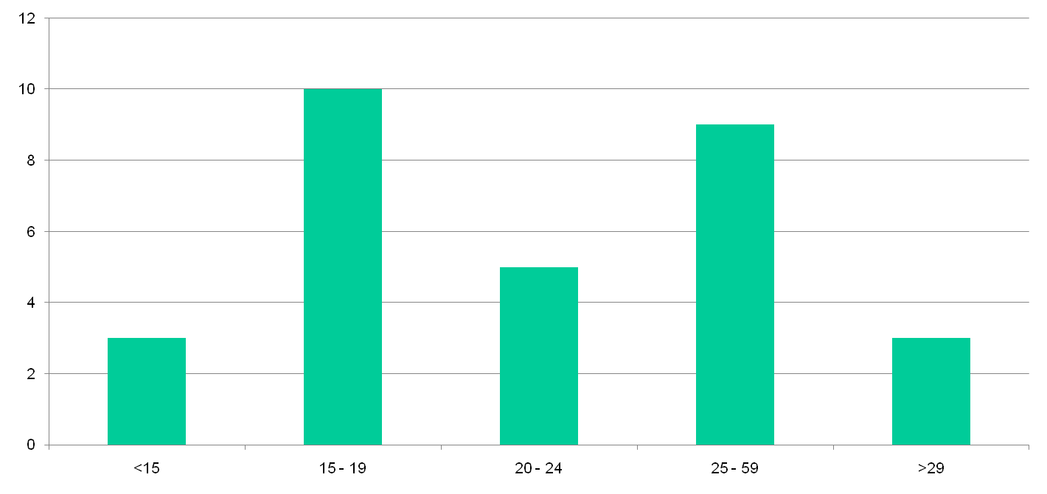
Histogram

Slide 37
Histogram
  Histograms are relatively easy to construct
  The size and location of the bins is key to a readable chart
  Consider the next slide which has more bins

Slide 38
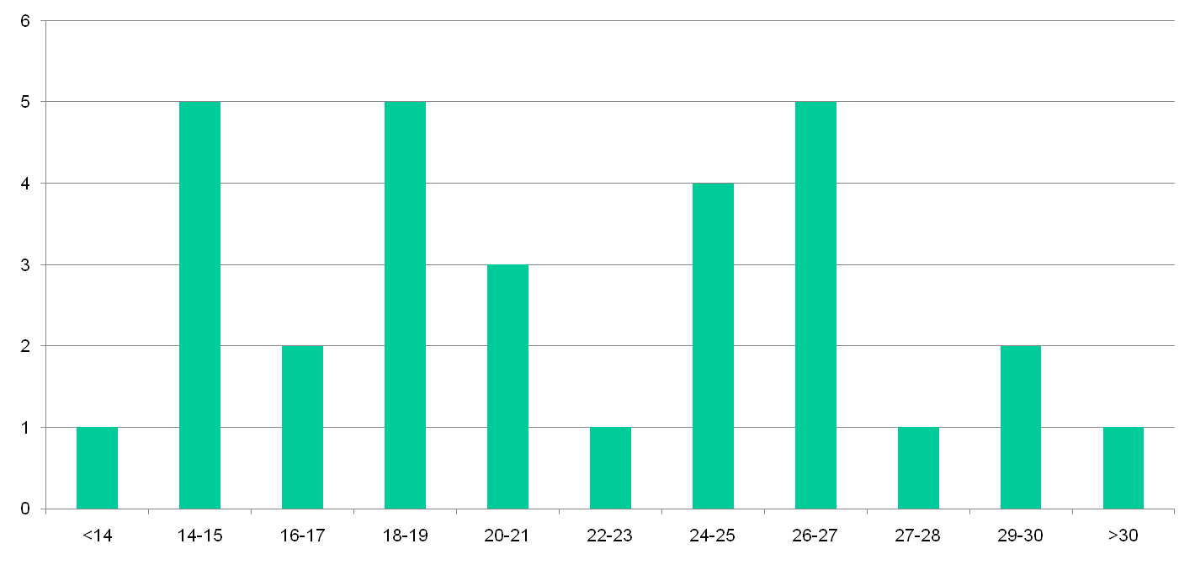
Histogram – bins of size 2

Slide 39
Bar Charts and Pie Charts
  Used for categorical data (i.e. data placed in categories)
  Generally used to show relative frequencies

Slide 40
Bar Charts and Pie Charts
  A class of 40 students is asked to pick their favourite fruit from the list of 4 given below
    Apple, Orange, Melon, Mango
  In the class
    20 chose Mango
    14 chose Melon
    4 chose Orange
    2 chose Apple

Slide 41
Bar Charts and Pie Charts
Category | Number | Relative Frequency (%)
Mango | 20 | 50
Melon | 14 | 35
Orange | 4 | 10
Apple | 2 | 5

Slide 42
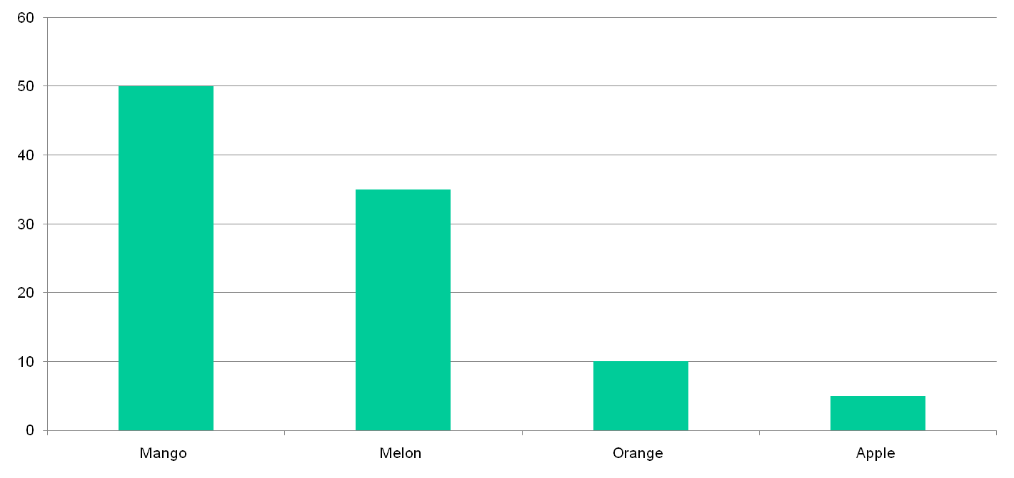
Bar Chart

Slide 43
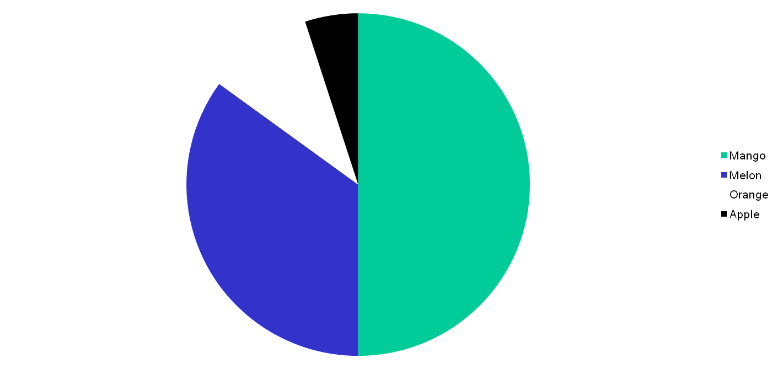
Pie Chart

Slide 44
Time Series
  Show changing value with time
  Consider the variation of temperature given earlier
19, 18, 17, 25, 26, 26, 27, 26, 30, 32, 25, 14, 15, 15, 14, 17, 19, 13, 25, 25, 26, 30, 24, 23, 21, 21, 19, 19, 21, 15
  This can be plotted as a time series
  Assume that this is for days in June

Slide 45
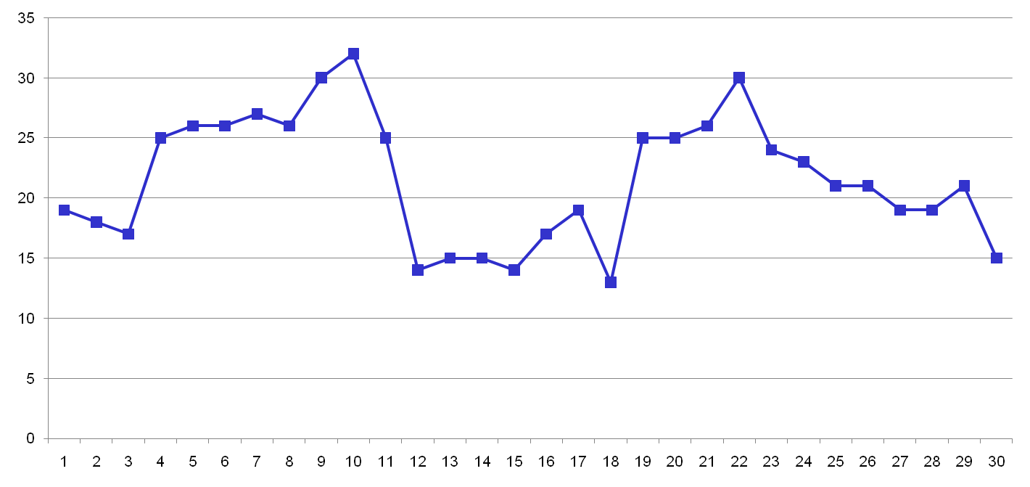
Time Series Plot

Slide 46
Topic 10 – Presenting Results
Any questions?
Notes:
NCC Education - End Slide Master

